Slide 1
History of the Atomic Model

Slide 2
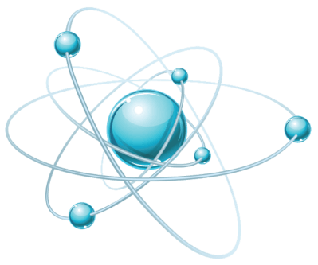
Atoms are the incredibly tiny particles that everything is made of!

Slide 3
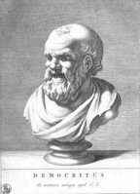
The current model of the atom has not been around forever!
Over 2000 years ago a Greek philosopher called Democritus hypothesised about dividing a material again and again until you cannot divide it any more. He called what remained an atomos, which is Greek for indivisible.

Slide 4
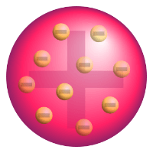
Models of atomic structure.
English chemist John Dalton proposed in 1803 that matter was composed of solid, indivisible spheres which cannot be destroyed. But what was the structure of the spheres?
The first widely accepted model of the atom was J. J. Thomson's model of the atom in 1904, shortly after the discovery of electrons. Thomson suggested that the electrons were randomly scattered within a positive matrix, like plums in a plum pudding. This earned the nickname the plum-pudding model.

Slide 5
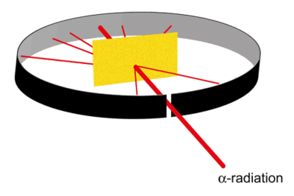
Experimental evidence led to a new theory.
A former student of J. J. Thomson, Ernest Rutherford disproved Thomson's model of the atom by firing α-radiation at an incredibly thin sheet of gold foil. If Thomson's model was true, then the radiation should have gone directly through with very little spread. Instead, Rutherford found that a small amount of radiation was deflected, and an even smaller amount bounced completely back.

Slide 6
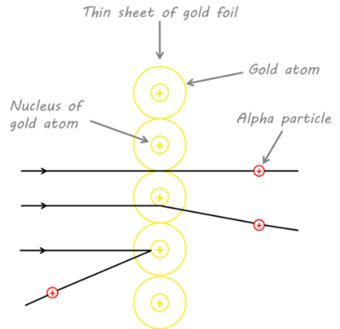
Rutherford's observations suggested two things:
1. | All the mass and positive charge are found in a small portion of the atom, as it takes a very dense positive mass to deflect the fast moving α-radiation particles. He called this the nucleus.
2. | Most of an atom is empty space, since the path for most of the α-radiation particles was unaffected.

Slide 7
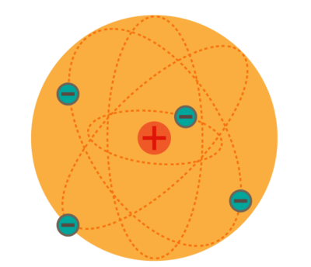
Rutherford believed that the electrons orbited this newly discovered nucleus, like planets around a sun.

Slide 8
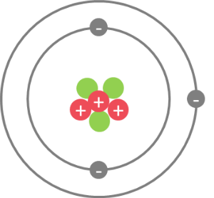
Niels Bohr's model of the atom.
Niels Bohr provided the next piece to the model in 1913 by observing that electrons could only orbit stably at specific distances from the nucleus. We call these distances electron shells, each of which corresponds to electrons with a certain energy level.

Slide 9
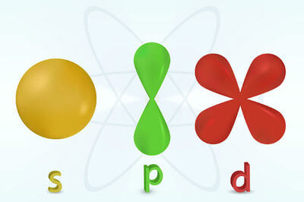
Quantum Mechanical Model.
As understanding of matter evolved, scientists realised waves could exhibit particle like properties and vice versa.
The Austrian scientist, Erwin Schrödinger treated electrons as waves and in 1926 proposed the Quantum Mechanical model of atomic structure. In this model there are orbitals which show where the electrons are likely to be 90% of the time! It shows the probability of an electron being within a given region of the atom.

Slide 10
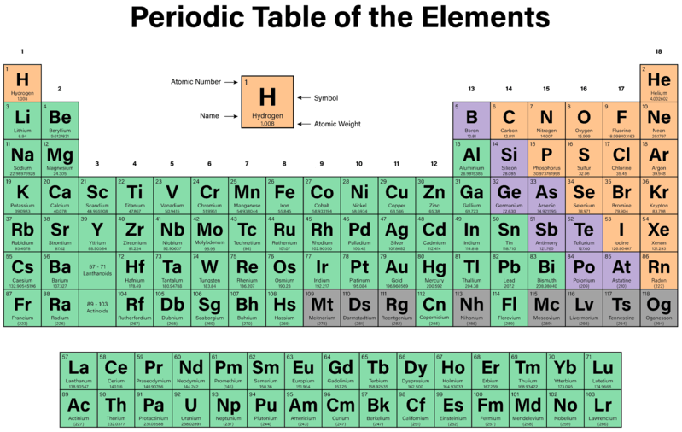
The atomic number of an atom is how many protons the nucleus has.
This is what defines an element! If an atom has 1 proton, it is hydrogen. If it has 8 protons, it is oxygen and if it has 94 protons, it is plutonium.

Slide 11
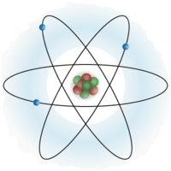
The atomic mass of an element is the combined mass of the protons and neutrons in the nucleus.
If you just want to know the number of neutrons, subtract the atomic number from the atomic mass, then round to the nearest whole number.

Slide 12
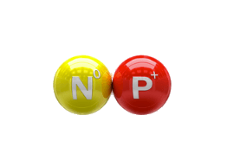
It may seem strange, but the atomic mass of an element is usually not a whole number.
This is because elements can have different isotopes, which are atoms with the same number of protons, and different amounts of neutrons.
The atomic mass is the average mass of all known isotopes of an element.

Slide 13
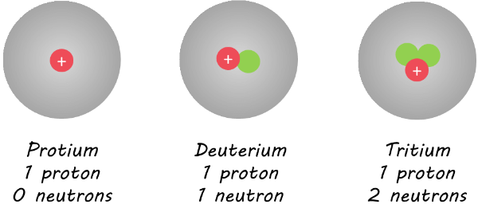
Hydrogen has three isotopes, however protium (with an atomic mass of 1) accounts for 99.99% of the hydrogen found on earth.
This is why the atomic mass of hydrogen is 1.008. Most hydrogen has a mass of 1, but 0.001% is heavier (atomic masses of 2 and 3), which increases the average very slightly.

Slide 14
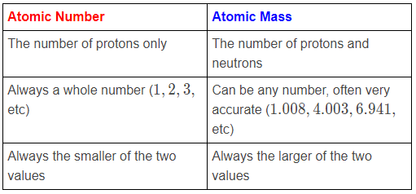
It can be very easy to mix these two values up, so here are some hints for remembering which is which:

